Slide 1

BigDataBenchMarks
Mid-Progress-Presentation.
Kranthi Kiran Reddy Vanga(16274077)
Bhavaz Akula(16282638)

Slide 2

Modifications:
We have found that for the scale of data we have and being an academia project AWS is not a cost effective solution for academia project
So we have moved to itversity labs which provides bigdata cluster at lesser cost.
- It provides a cluster with 400GB ram at much cheaper price
For visualization we have found that databricks community edition of spark is better solution and provides data storage service too.
So, we have moved away from MongoDB.

Slide 3
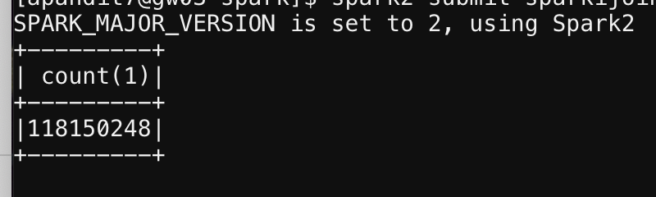
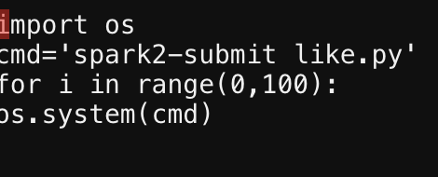
Let’s speak with Images:
The scale of the data used:
Shell script to run query

Slide 4
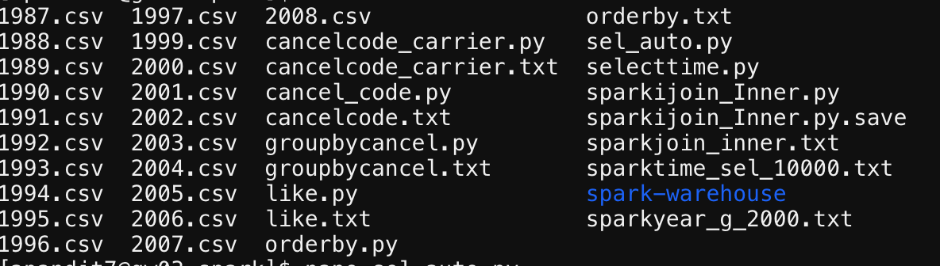
Let’s speak with Images:

Slide 5
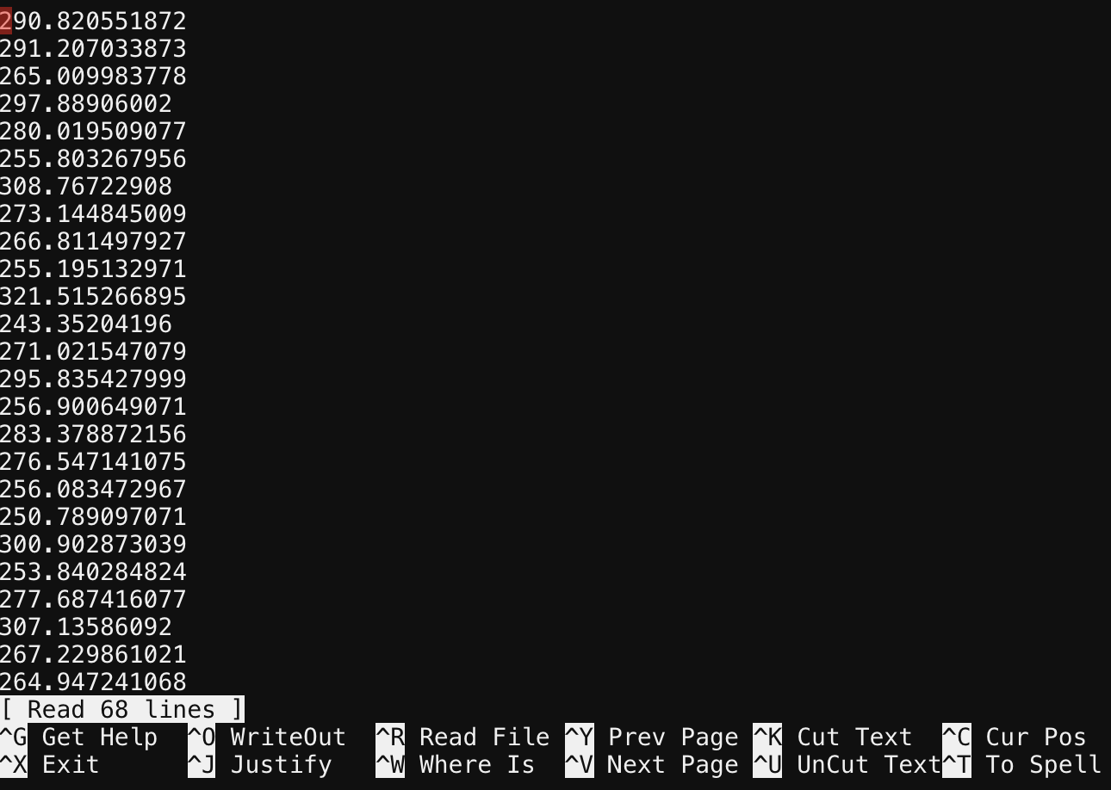
Let’s speak with Images:

Slide 6
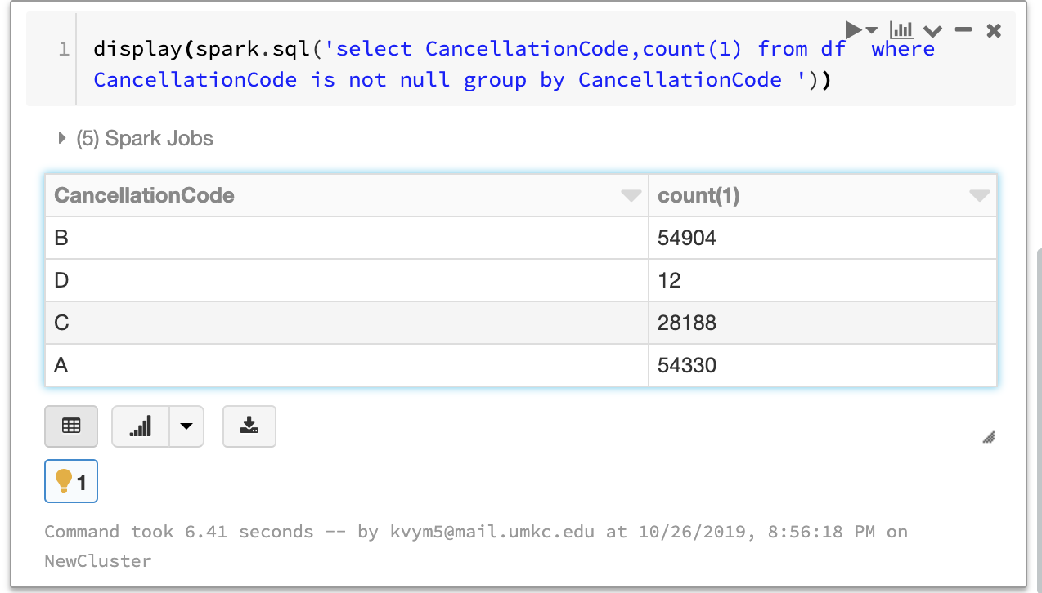
Let’s speak with Images:
Using Databricks student edition for data visualization.

Slide 7
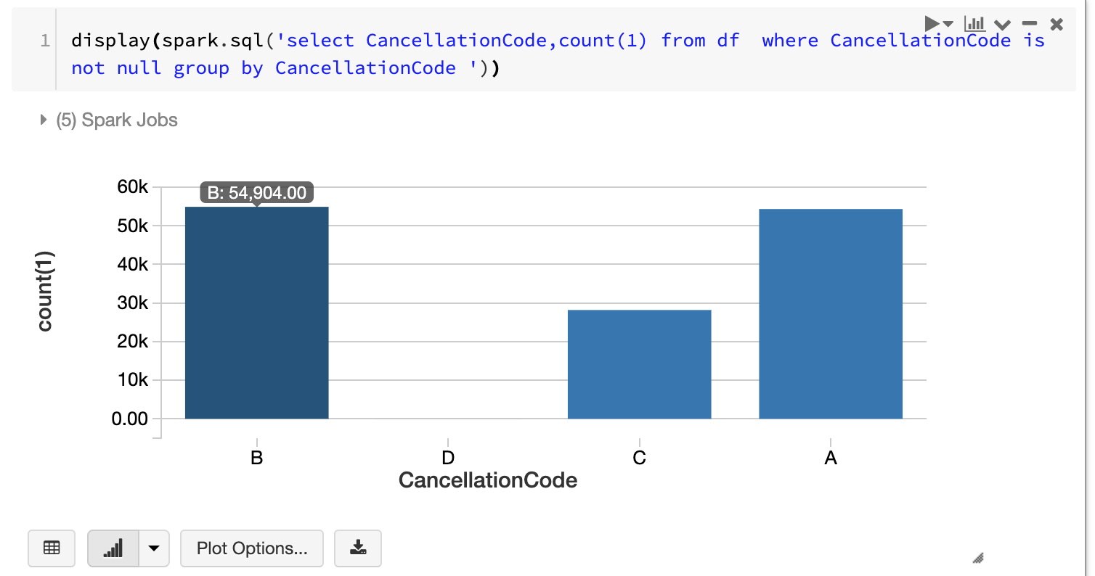
Let’s speak with Images:
This is Bar plot for the above query.

Slide 8
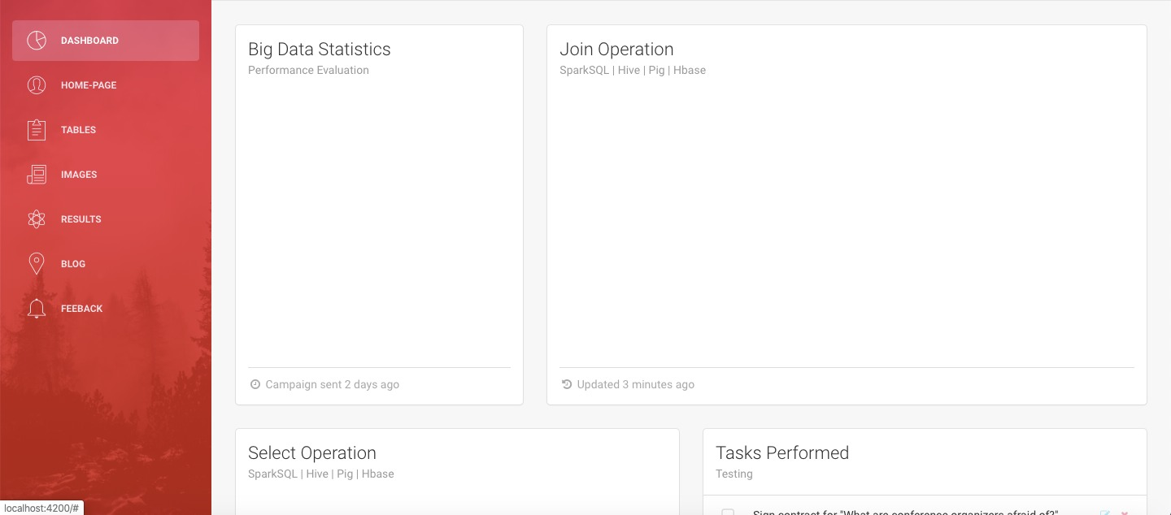
UI:

Slide 9
Where Do We Stand:
As of now we are using data of 120 Million records.
All the data has been engineered to get Pure Data.
Data is moved on to Hadoop cluster.
We are done with extracting query times for each query and saving data into files.
We have started to extract query time on data set by using Hive.

Slide 10
Where Do We Stand:
We have developed home page to show the results using angular.
The homepage consists of a dashboard which will navigate to other angular components which will describe our future work on hive, pig and HBase
Home page has side-bar which has options to navigate to different pages.
With the data engineered and all environments set up and done with the data collection for spark we are done with half of the work load for entire project.

Slide 11
Issues Faced:
GC overhead error for running out of memory.
This error was due to the cartesian product nature of join operation which unfortunately could not be overcomed so we scaled the data down for join operation.
Query Times for join is more than 300 seconds with data scaled down to 1000 times
- As part of our project objective we had to run each query
100 times
Data engineering at such large scale was notoriously time taking.

Slide 12
Road Map:
Data Engineering
Collecting query time in each of it, Developing UI
setting up environment for sparkSql, hive, hbase, pig
Comparing the various platforms used and Visualizing
Moving data on to UI

Slide 13
Questions?

Slide 14
Thank you!

